Slide 1
Docker

Slide 2
lets summarize our learning till now
Virtual Machines are slow and take a lot of time to boot.
Containers are fast and boots quickly as it uses host operating system and shares the relevant libraries.
Containers do not waste or block host resources unlike virtual machines.
Containers binaries specific to the application they are running.
Containers are handled by Containerization engine.
Docker is one of the containerization platforms which can be used to create and run containers.

Slide 3
What is Docker & Docker Container
Docker is a containerization platform that packages your application and all its dependencies together in the form of a docker container to ensure that your application works seamlessly in any environment
Docker Container is a standardized unit which can be created on the fly to deploy a particular application or environment. It could be an Ubuntu container, CentOs container, etc. to full-fill the requirement from an operating system point of view. Also, it could be an application oriented container like CakePHP container or a Tomcat-Ubuntu container etc.

Slide 4
Let’s understand it with an example:
A company needs to develop a Java Application.
In order to do so the developer will setup an environment with tomcat server installed in it
Once the application is developed, it needs to be tested by the tester
Now the tester will again set up tomcat environment from the scratch to test the application
Once the application testing is done, it will be deployed on the production server
Again the production needs an environment with tomcat installed on it, so that it can host the Java application
If you see the same tomcat environment setup is done thrice

Slide 5
There are some issues with this approach
There is a loss of time and effort.
2) There could be a version mismatch in different setups i.e. the developer & tester may have installed tomcat 7, however the system admin installed tomcat 9 on the production server.

Slide 6
how Docker container can be used to prevent this?
The developer will create a tomcat docker image ( An Image is nothing but a blueprint to deploy multiple containers of the same configurations ) using a base image like Ubuntu, which is already existing in Docker Hub (the Hub has some base images available for free)
Now this image can be used by the developer, the tester and the system admin to deploy the tomcat environment
This is how this container solves the problem

Slide 7
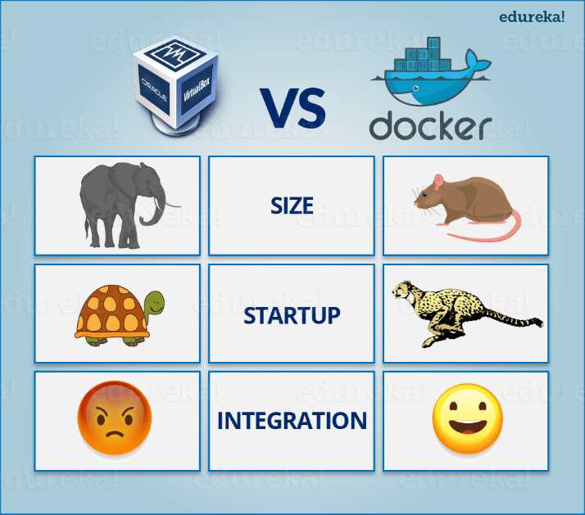
One would think that this same approach can be done using Virtual Machines as well
However, there is catch if you choose to use virtual machine
Let’s see a comparison between the two to understand this better

Slide 8
Virtual Machine and Docker Container are compared on the following three parameters
Size – This parameter will compare Virtual Machine & Docker Container on their resource they utilize.
Startup – This parameter will compare on the basis of their boot time.
Integration – This parameter will compare on their ability to integrate with other tools with ease.

Slide 9
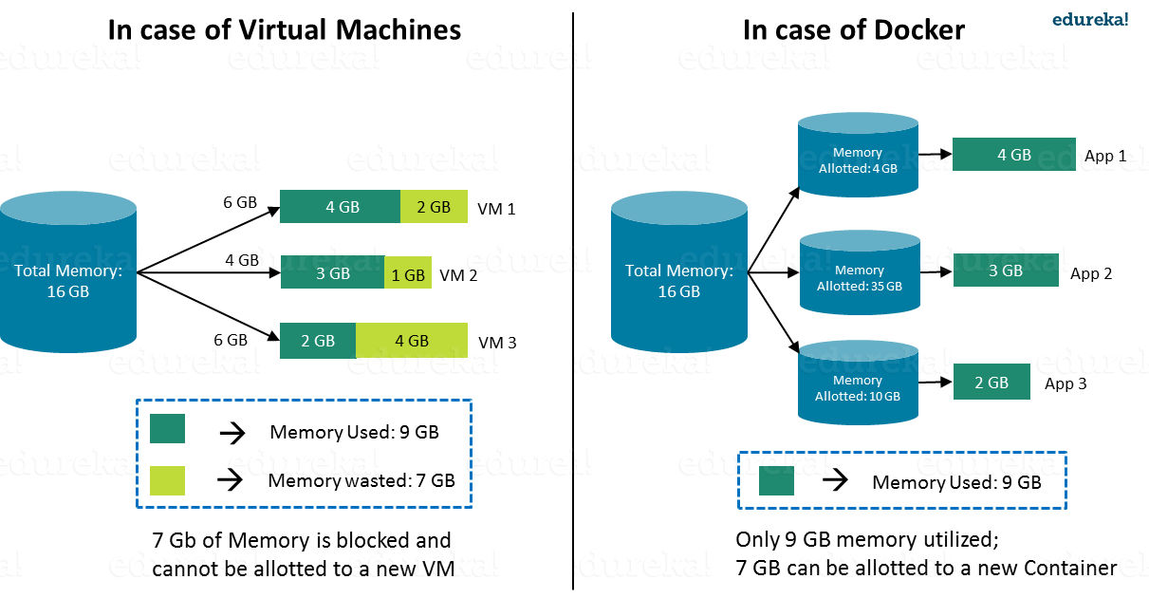
Size
The following image explains how Virtual Machine and Docker Container utilize the resources allocated to them.
VM
Docker

Slide 10
Start-Up
When it comes to start-up, Virtual Machine takes a lot of time to boot up because the guest operating system needs to start from scratch, which will then load all the binaries and libraries
This is time consuming and will prove very costly at times when quick startup of applications is needed
In case of Docker Container, since the container runs on your host OS, you can save precious boot-up time
This is a clear advantage over Virtual Machine.

Slide 11
Consider a situation where I want to install two different versions of Ruby on my system
If I use Virtual Machine, I will need to set up 2 different Virtual Machines to run the different versions. Each of these will have its own set of binaries and libraries while running on different guest operating systems.
Whereas if I use Docker Container, even though I will be creating 2 different containers where each container will have its own set of binaries and libraries, I will be running them on my host operating system
Running them straight on my Host operating system makes my Docker Containers lightweight and faster.

Slide 12
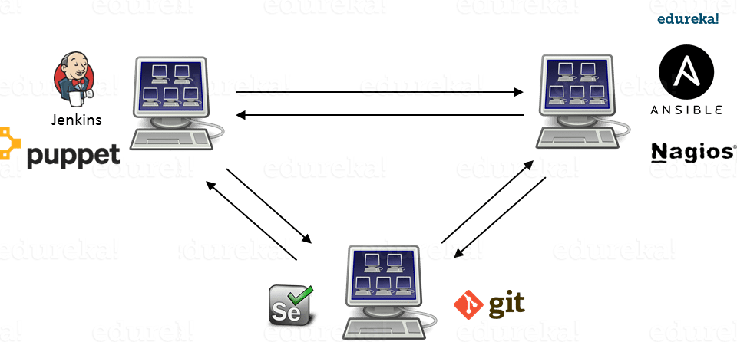
Integration

Slide 13
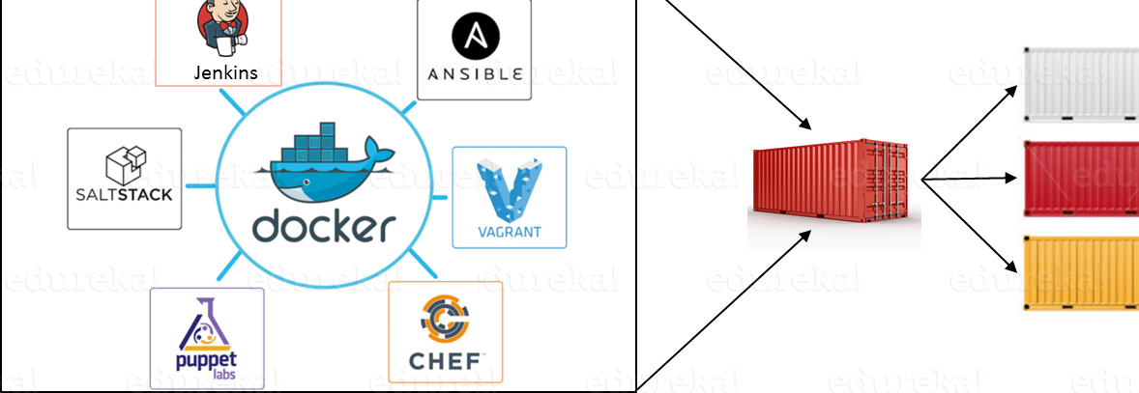

Slide 14
What is Docker Engine?
Docker Engine is simply the application that is installed on your host machine. It works like a client-server application which uses:
A server which is a type of long-running program called a daemon process
A command line interface (CLI) client
REST API is used for communication between the CLI client and Docker Daemon

Slide 15
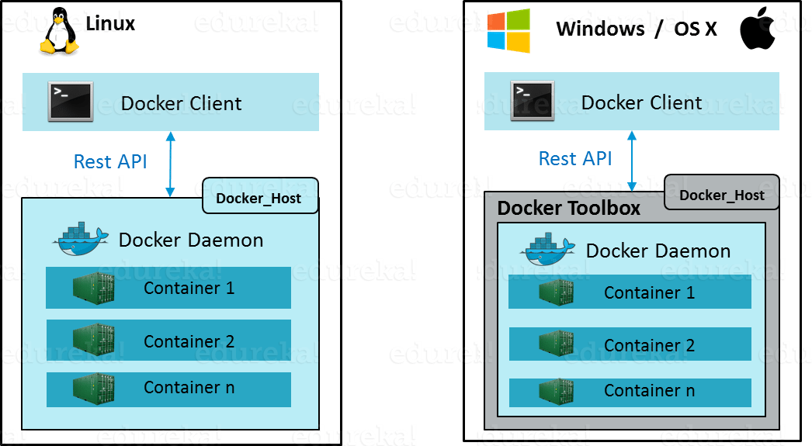
As per the below image, in a Linux Operating system, there is a client which can be accessed from the terminal and a Host which runs the Daemon. We build our images and run containers by passing commands from the CLI client to the Daemon
However, in case of Windows/Mac there is an additional Toolbox component inside the Docker host. This Docker Toolbox is an installer to quickly and easily install and setup a Docker environment on your Windows/iOS. This Toolbox installs Docker Client, Machine, Compose (Mac only), Kitematic and VirtualBox.

Slide 16
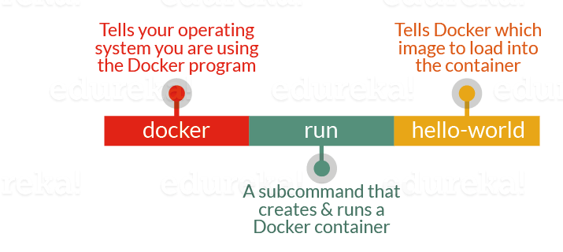
What is Docker Image?
Docker Image can be compared to a template which is used to create Docker Containers. They are the building blocks of a Docker Container. These Docker Images are created using the build command. These Read only templates are used for creating containers by using the run command

Slide 17
Docker lets people (or companies) create and share software through Docker images. Also, you don’t have to worry about whether your computer can run the software in a Docker image — a Docker container can always run it.
We can either use a ready-made docker image from docker-hub or create a new image as per my requiremen

Slide 18
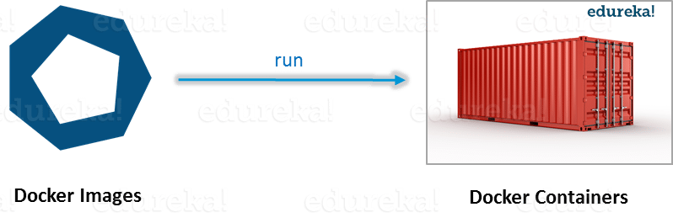
What is Docker Container?
Docker Containers are the ready applications created from Docker Images. Or you can say they are running instances of the Images and they hold the entire package needed to run the application. This happens to be the ultimate utility of the technology.

Slide 19
What is Docker Registry?
Finally, Docker Registry is where the Docker Images are stored
The Registry can be either a user’s local repository or a public repository like a Docker Hub allowing multiple users to collaborate in building an application
Even with multiple teams within the same organization can exchange or share containers by uploading them to the Docker Hub, which is a cloud repository similar to GitHub.

Slide 20
What is Docker Architecture?
Docker Architecture includes a Docker client – used to trigger Docker commands, a Docker Host – running the Docker Daemon and a Docker Registry – storing Docker Images
The Docker Daemon running within Docker Host is responsible for the images and containers.

Slide 21
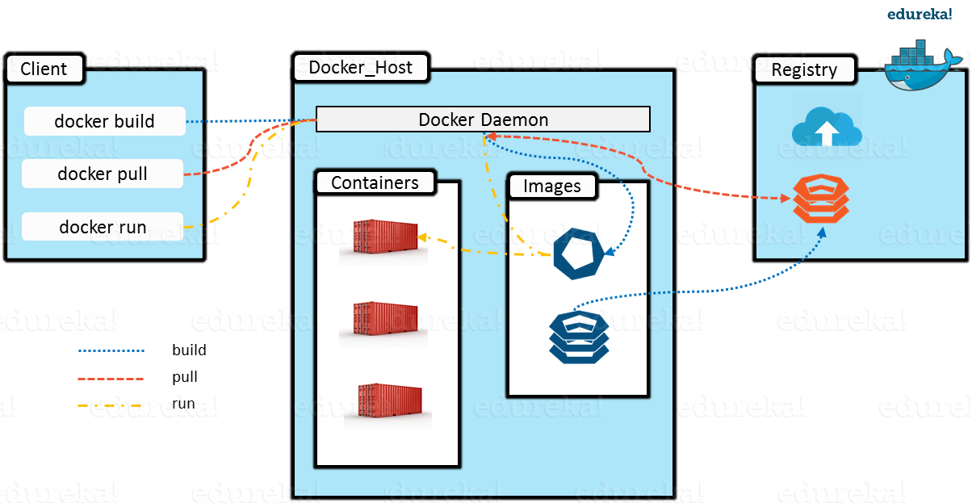

Slide 22
To build a Docker Image, we can use the CLI (client) to issue a build command to the Docker Daemon (running on Docker_Host). The Daemon will then build an image based on our inputs and save it in the Registry, which can be either Docker hub or a local repository
If we do not want to create an image, then we can just pull an image from the Docker hub, which would have been built by a different user
Finally, if we have to create a running instance of my Docker image, we can issue a run command from the CLI, which will create a Container

Slide 23
Docker Commands
docker –version
docker pull
docker run
docker ps
docker ps -a
docker exec
docker stop
docker kill
docker commit
docker login
docker push
docker images
docker rm
docker rmi
docker build

Slide 24
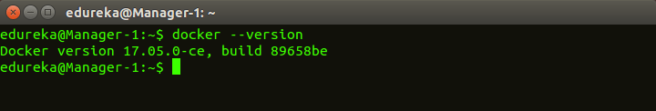
docker –version
This command is used to get the currently installed version of docker

Slide 25
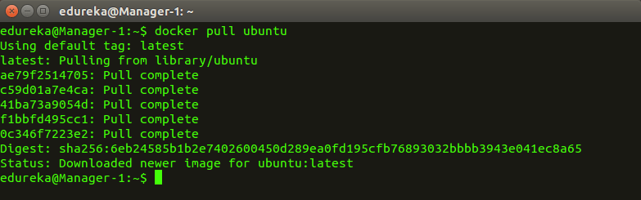
docker pull
Usage: docker pull <image name>
This command is used to pull images from the docker repository(hub.docker.com)

Slide 26
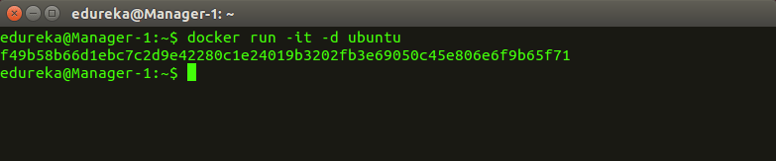
docker run
Usage: docker run -it -d <image name>
This command is used to create a container from an image

Slide 27
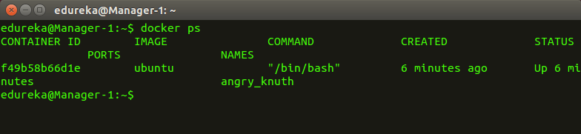
docker ps
This command is used to list the running containers

Slide 28
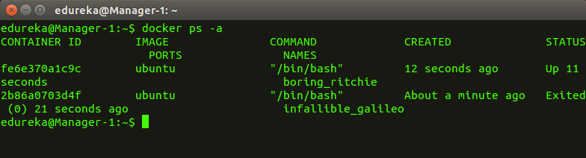
docker ps -a
This command is used to show all the running and exited containers

Slide 29
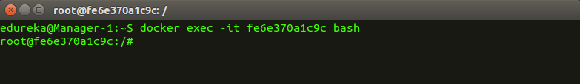
docker exec
Usage: docker exec -it <container id> bash
This command is used to access the running container

Slide 30
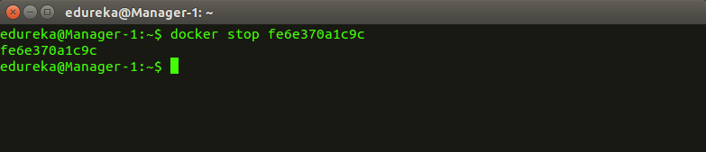
docker stop
Usage: docker stop <container id>
This command stops a running container

Slide 31
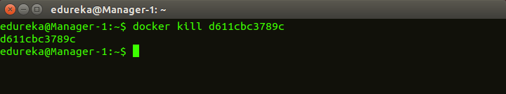
docker kill
Usage: docker kill <container id>
This command kills the container by stopping its execution immediately. The difference between ‘docker kill’ and ‘docker stop’ is that ‘docker stop’ gives the container time to shutdown gracefully, in situations when it is taking too much time for getting the container to stop, one can opt to kill it

Slide 32
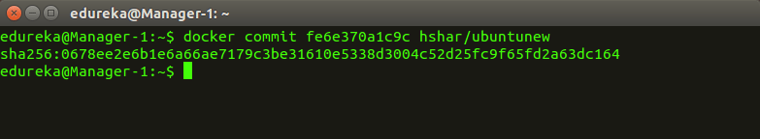
docker commit
Usage: docker commit <conatainer id> <username/imagename>
This command creates a new image of an edited container on the local system

Slide 33
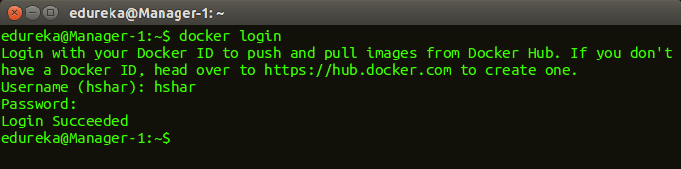
docker login
docker login
This command is used to login to the docker hub repository

Slide 34
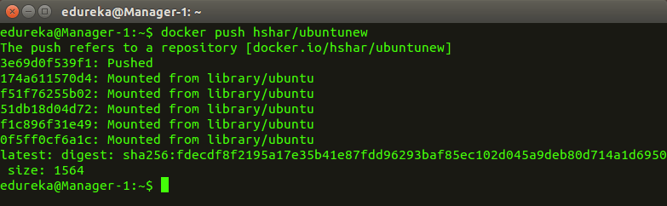
docker push
Usage: docker push <username/image name>
This command is used to push an image to the docker hub repository

Slide 35
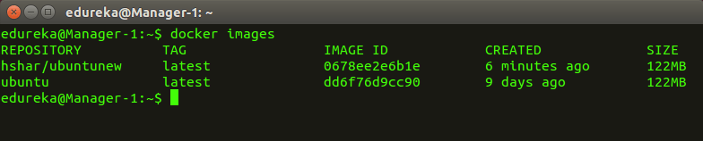
docker images
This command lists all the locally stored docker images

Slide 36
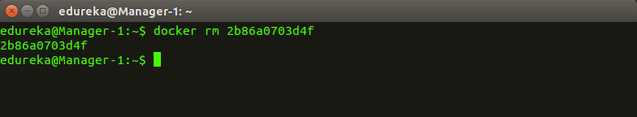
docker rm
Usage: docker rm <container id>

Slide 37

Docker File
Dockerfile is instructions to build Docker image
How to run commands
Add files or directories
Create environment variables
What process to run when launching container
Result from building Dockerfile is Docker image

Slide 38
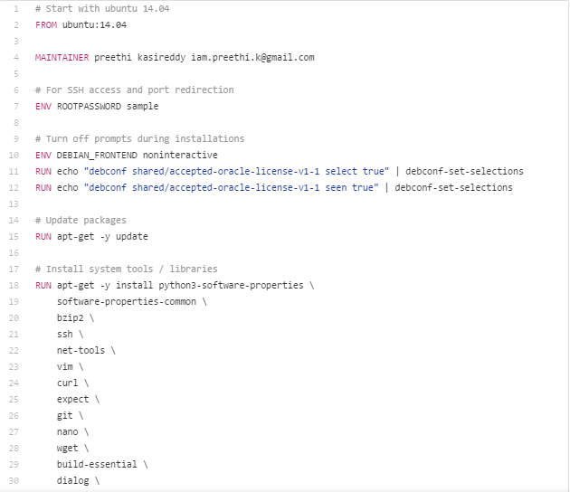
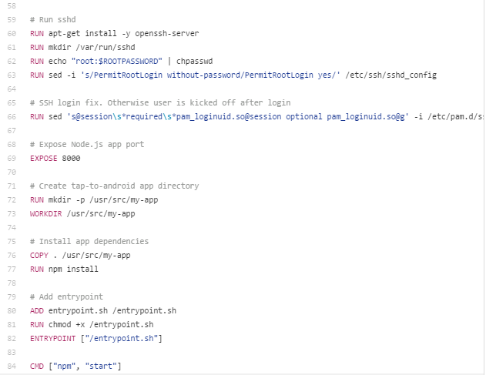
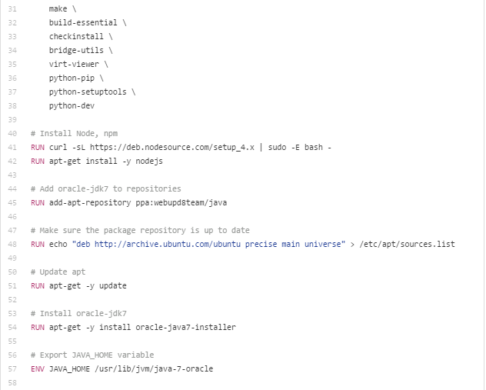

Slide 39
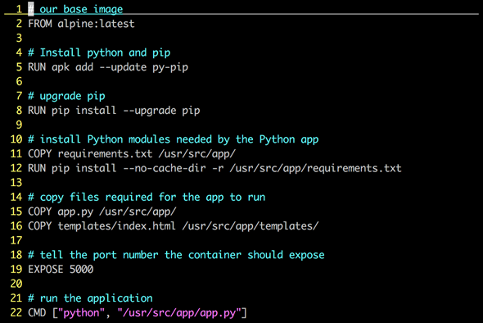
Dockerfile – Linux Example

Slide 40
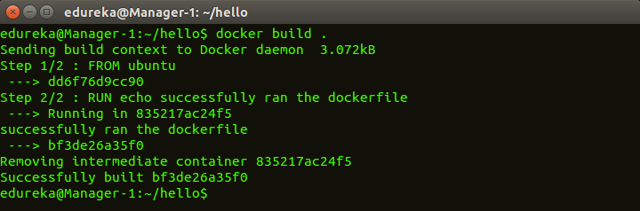
docker build
Usage: docker build <path to docker file>
This command is used to build an image from a specified docker file

Slide 41
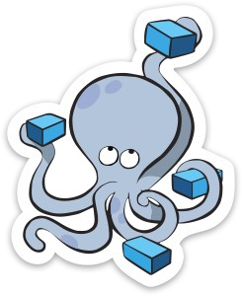
Docker Compose
Tool for defining and running multi-container
applications with Docker in a single file
Fast, isolated development environments using Docker.
Quick and easy to start.

Slide 42
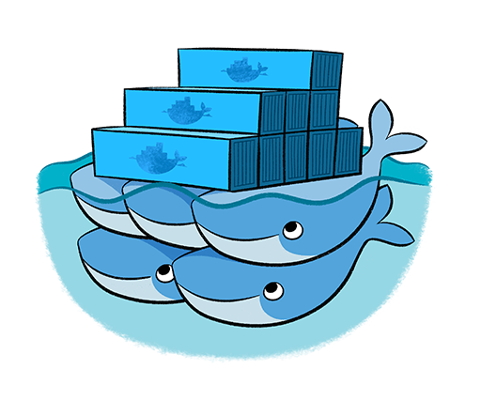
Docker Swarm
Native Clustering System
Clustering (management) for Docker.
Manage multiple Docker daemons.
Distribute workloads.

Slide 43
Assignment
Video
https://www.youtube.com/watch?v=4OLlKGT7aVQ
Article
https://netflixtechblog.com/the-evolution-of-container-usage-at-netflix-3abfc096781b
Go through these links and make a comprehensive report / ppt (Deadline: Next Week)

